Slide 1

PHISHING AWARENESS MODULE
Learn how to identify, prevent, and report phishing attacks
Prepared by:
FRIMPONG TRACY KWAKYEWAA KUMI

Slide 2
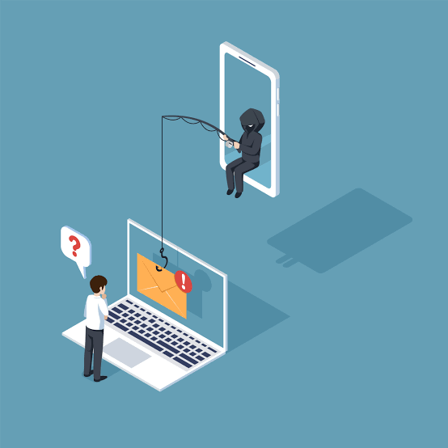
Learning Objectives By the end of the module , you will be able to:
Define phishing attacks
Identify common phishing methods
Recognize warning signs
Apply prevention techniques
Report suspicious activities

Slide 3
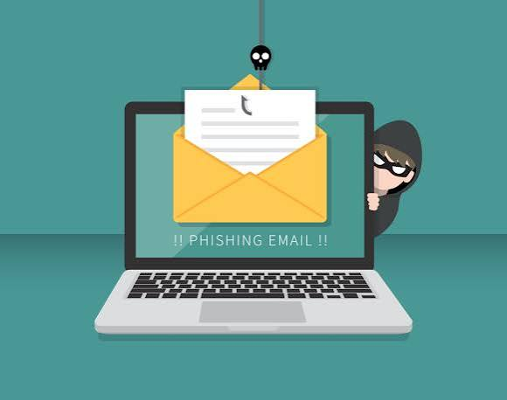
What is Phishing
Phishing is a cyberattack in which criminals impersonate trusted individuals or organizations to trick users into revealing sensitive information.
Examples:
Password
Bank details
Personal information

Slide 4
Email Phishing
Spear Phishing
Fraudulent emails pretending to come from trusted organizations.
Personalized attacks targeting specific individuals
Smishing
Vishing
Fake SMS message requesting urgent action
Phone calls pretending to be legitimate organization

Slide 5
Attacker
Fake Email
Victim clicks
Information stolen
The attacker creates a convincing fake message. Once the victim clicks a malicious link or attachment, sensitive information may be stolen or malware installed.

Slide 6
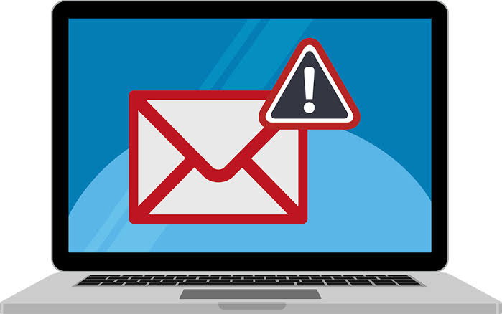
Warning Signs of Phishing
Urgent language
Unknown sender
Poor spelling and grammar
Suspicious links
Unexpected attachments
Request for password
Remember:
If something feels suspicious, verify it before clicking.

Slide 7
Realistic Phishing Email Example
From:
Support@amazon-security.com
Subject:
Your account will be suspended.
Dear customer,
Your account has unusual activity.
Verify immediately by clicking below.
Verify account
Fake sender
Urgent language
Suspicious link
Generic greeting
Requests personal information

Slide 8
Strong password
Check sender
Two factor authentication
Update software
Verify link
Report suspicious Emails

Slide 9
1
Do not click links
2
Report Email
3
Delete Email
4
Change your password if necessary
5
Run an antivirus scan if you clicked anything

Slide 10
Knowledge Quiz
Question :
Which of the following is a sign of phishing?
Email from your lecturer using your university address
Email asking you to verify your password immediately
Class timetable notification
Library reminder
Correct answer:
B

Slide 11
Key Takeaways
Never trust unexpected emails.
Verify before clicking.
Enable Two-Factor Authentication.
Use strong password.
Report suspicious messages immediately.
Cybersecurity starts with you.

Slide 12

THANK YOU
Stay Alert.
Stay Secure.
Think Before You Click.
Questions?

